Slide 1
In Memoriam
Celebration of Life
Massachusetts State Organization of
The Delta Kappa Gamma Society International
2022 Spring Convention
Plymouth, MA
May 1, 2022

Slide 2
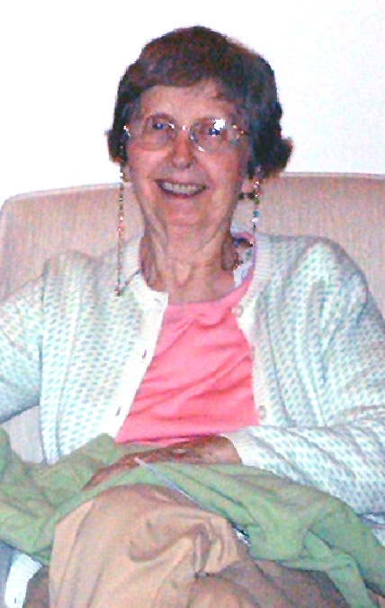
KATHLEEN FOLEY Alpha Chapter Initiated 5/18/1985 November 19, 2020 35 years
Kathy was a faithful DKG member. When Iota Chapter dissolved, she transferred into Alpha Chapter.
She worked as a social worker in family service agencies in MA and in school systems in Wilbraham, MA and Windsor, Ct. Early childhood development was her special expertise.

Slide 3
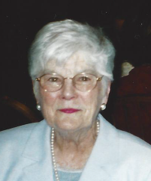
JANET REGAN Alpha Chapter Initiated 11/1/1973 April 22, 2020 47 years
During her long, devoted membership in Alpha Chapter, Janet held a variety of offices, including Chapter President.
She worked for many years as a Speech Language Pathologist in the Springfield Public Schools and then became a supervisor of speech/language/hearing/ and vision staff in that system.

Slide 4
MARJORIE IVES Epsilon Chapter Initiated 12/1/1979 November 5, 2020 41 years
Marjorie was in DKG as a longstanding dedicated member and a Past President of Epsilon Chapter.
She was a 35-year Public School teacher first at the Countryside School in Newton and then at the Horace Mann School and Saltonstall School in Salem, MA.

Slide 5
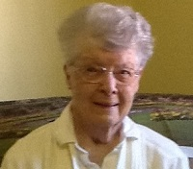
BARBARA PURINGTON Epsilon Chapter Initiated 12/1/1965 March 18, 2019 54 years
Barbara was a longstanding, dedicated member of DKG and was a Past President of Epsilon Chapter. She was a first-grade teacher for 26 years at the Yellow School in Byfield, MA.

Slide 6
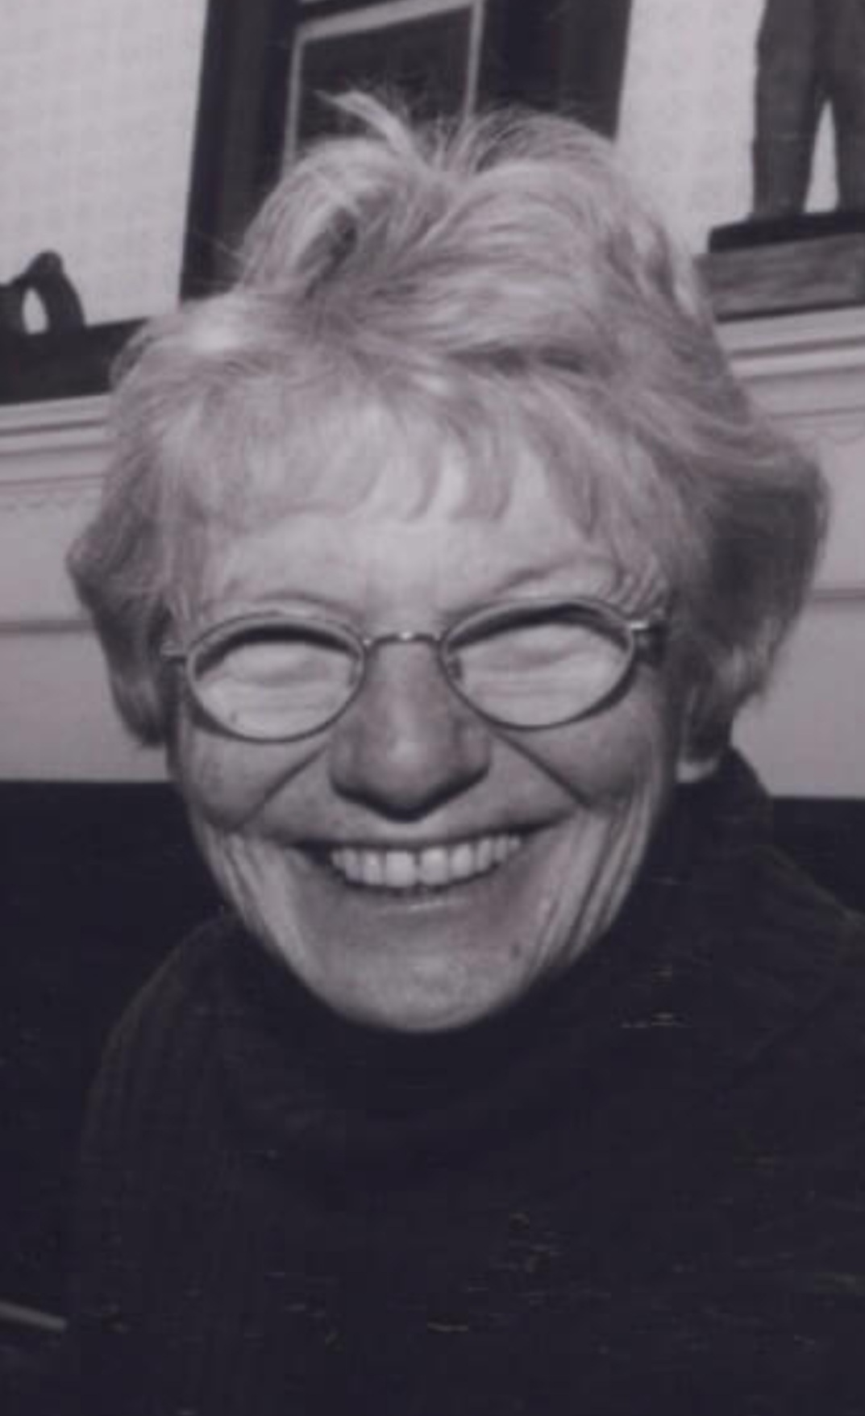
NORMA SIMONS
Zeta Chapter Initiated 1/1/1998 November 2, 2018
20 years
Norma was an Honorary member of Zeta Chapter.
She was a prolific children’s book author of over 50 books, many of them in the area of diversity. Norma worked with the children in the Wellfleet schools to encourage them to write their own stories.

Slide 7
ROBERTA BRALEY Eta Chapter Initiated 5/1/1975 January 9, 2020 45 years
Roberta held multiple offices in Eta Chapter, including Chapter President. She was also on various committees at the State level during her 45 years of membership. She was a special education diagnostician for the Town of Fairhaven School System for 30 years.

Slide 8
BONNIE BRAZ Eta Chapter Initiated 5/1/1993 May 4, 2020 27 years
Bonnie was a dedicated member and served 2 biennium as Eta Chapter President.
She was employed by the New Bedford School System as a Bilingual (ESL) teacher at the Middle school level for 35 years.

Slide 9
LOUISE COGGESHALL Eta Chapter Initiated 5/15/2008 October 4, 2021 13 years
Louise was an active member of Eta Chapter and served on the Executive Board for six years. She was very active in our literacy auction.
She taught at Devalles Elementary
School for 37 years and was very active with the Acushnet Library book drives and book sales.

Slide 10
GLADYS GAJ Eta Chapter Initiated 4/1/1967 August 17, 2019 52 years
Gladys was an active chapter member and served as Treasurer of Eta Chapter for 10 years. She was a business education teacher at Dartmouth High School for 28 years. She was actively involved in the Bristol County Retired Teachers, a Chapter of REAM, serving in many various offices, including President.

Slide 11
DR. AMY GRACIA Eta Chapter Initiated 5/18/2011 December 28, 2020 9 years
Amy recently served as Eta Chapter’s Co-President and was actively involved in the chapter since her initiation.
She was employed as a Literacy Teacher at Greater New Bedford Regional Vocational Technical High School for 9 years and was an Online Learning Administrator.

Slide 12
LINDA MEREDITH Eta Chapter Initiated 5/1/1998 October 8, 2021 28 years
Linda was an active member of Eta Chapter for 28 years.
She was a special education teacher for 35 years, spending most of her career at Fairhaven High School.

Slide 13
CONCETTA RANDO Eta Chapter Initiated 4/1/1969 December 25, 2020 51 years
Connie was initially a member of Omega Chapter and because of her dedication to DKG, she transferred into Eta Chapter when her chapter dissolved.
She was a second-grade teacher for 41 years at the Lynn Woods School in Lynn, MA.
She was the oldest living member of Alpha Upsilon, passing at 109 years old.

Slide 14
CYNTHIA STONE Eta Chapter Initiated 5/1/1995 January 20, 2021 26 years
Cindy was an active member and served on the Executive Board for years. She was an avid traveler and would often present beautiful travelogues to the chapter. She was also an active participant in the chapter’s literacy programs.
She was a teacher in the Acushnet Elementary School for 35 years where she was a reading specialist.

Slide 15
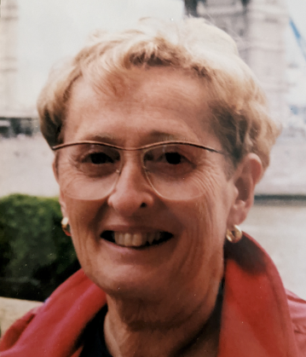
MARILYN BOULAIS
Theta Chapter Initiated 4/1/1972 October 26, 2019 47 years
Marilyn was a faithful member of Theta Chapter and served on various committees during her 47 years of membership.
Marilyn taught in Walpole for 35 years at the Plimpton School and Bird Middle School.

Slide 16
MARION O’NEIL BOWE Theta Chapter Initiated 12/1/1965 April 26, 2021 56 years
Marion was an active member of Theta Chapter. She was a Past President and was Theta’s historian for many years.
Marion was a dedicated elementary art teacher in the Walpole school system for over 30 years.

Slide 17
Mary (Cherry)Hathaway Kappa Chapter Initiated 5/1/1964 December 31, 2021 57 years
Mary was a very active member of Kappa Chapter. She was a former
Chapter President. Mary Cherry was also active at the State level serving as Baystate Editor for 8 years.
Mary taught English at Silver Lake Regional High School and was Chairperson of the English Department for many years.

Slide 18
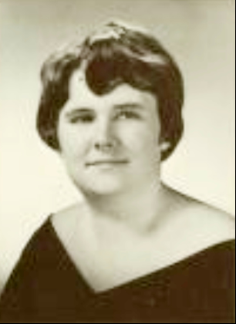
REBECCA RIDGWAY
Kappa Chapter Initiated 5/1/1977 November 22, 2019 43 years
Rebecca was a member of Kappa Chapter and served as Chapter President.
She was an educator in Halifax Elementary School for 27 years before moving to Florida.

Slide 19
BETTIE FERUZZI Upsilon Chapter Initiated 5/5/1999 February 1, 2022 23 years
Bettie was an active and dedicated member of Upsilon Chapter. She had a love for DKG and when she move to Georgia in September transferred into Alpha Iota in Georgia.
Bettie taught math in the Boston Public Schools for 32 years.

Slide 20
KATHERINE KELLEHER Upsilon Chapter Initiated 5/22/2003 August 19, 2019 16 years
Kathy was an active member of Upsilon Chapter.
She had a long career in science, technology and administration in the Boston Public School System.

Slide 21
ELMIRE PETIT
Upsilon Chapter Initiated 4/1/1956 January 24, 2019 63 years
Elmire was a Charter member of Upsilon Chapter. She was a former Chapter President and was a dedicated member for 63 years.
She was a French teacher for the Revere School System for 40 years.

Slide 22
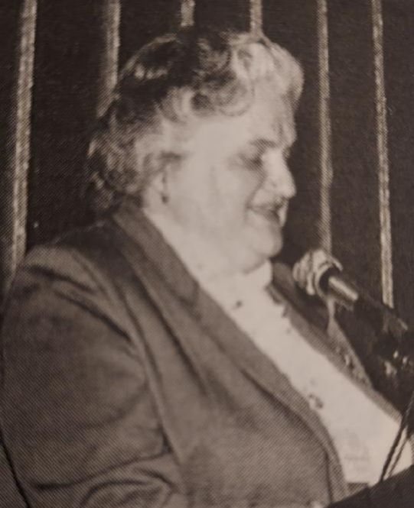
NANCY COOK
Alpha Alpha Chapter Initiated 4/1/1974 July 20, 2019 45 years
Nancy served as a Chapter President of Alpha Alpha Chapter. She was also on the Alpha Upsilon Executive Board as Corresponding Secretary for one biennium.
She was an elementary school teacher who retired after 30 years of teaching in various districts throughout the state.

Slide 23
BARBARA CLANCY Alpha Beta Chapter Initiated 10/1/1992 April 19, 2019 27 years
Barbara was initially initiated into Iota Chapter and served as Chapter President. She transferred to Alpha Beta Chapter when her chapter dissolved.
She taught in various schools in Boston as well at the Madison Park Vocational School where she taught commercial graphic arts.

Slide 24
HELEN McGARRY Alpha Beta Chapter Initiated 5/1/1964 December 20, 2021 57 years
Helen was the matriarch of her chapter and held many offices including Chapter President. Helen was very active at the State level. She attended over 50 Regional and International Conferences.
Helen was an English teacher in Sharon School system for 25 years.

Slide 25
LIZ TILEY Alpha Epsilon Chapter CHAPTER Initiated 6/1/2020 November 23, 2020 5 months
Liz was only a member of Alpha Epsilon Chapter for a short period of time.
She developed adult education programs and was the Director of the Worcester Night Life Program.

Slide 26
MARY EPPICH Alpha Zeta Chapter Initiated 4/1/1969 F February 26, 2020 50 years
Mary was a Charter member of Alpha Zeta Chapter. She served as Chapter President and held many other offices. She was active on the Coordinating Council Council at the state level.
She taught at the elementary level for over 40 years in the Norwell Schools.

Slide 27
HELEN FORSGARD Alpha Zeta Chapter Initiated 10/1/1978 November 23, 2019 41 years
.Helen was a dedicated member and former Chapter President. She was the recipient of the 1990 International Scholarship Award.
For 16 years she was the Scituate Jr. High Drama Coach. Over the years Helen held several teaching positions at multiple colleges throughout Massachusetts.

Slide 28
SHEILA KEARNEY Alpha Eta Chapter Initiated 5/1/1981 April 18, 2020 39 years
Sheila was initially initiated into Omega Chapter and transferred into Alpha Eta Chapter when her chapter dissolved. She was active at the chapter level as well as at the state level.
She was an elementary teacher at the Stanley School for 40 years and was a supervisor of student teachers in Swampscott for Salem State University for 14 years.

Slide 29
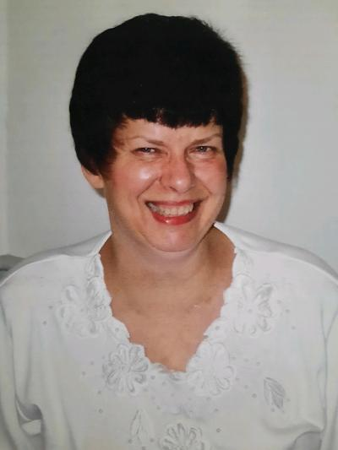
V
LINDA UPPER
Alpha Eta Chapter
Initiated 5/1/1981
January 28, 2020
39 years
Linda was an active member for as long as her health permitted and will be remembered for her lovely smile and warm, cheerful disposition.
She loved music and was a band director and music teacher for 39 years at the Masconomet Middle School in Boxford.

Slide 30
ESTELLE BLACKMAN Alpha Kappa Chapter Initiated 4/1/1974 March 5, 2020 46 years
Estelle was an active member of her chapter, serving in many various offices, including Chapter President.
She was a teacher in the Brockton at the Lincoln Elementary School, West Jr. High School, Gilmore Elementary School, old Brockton High School.

Slide 31
MARCIA CROOKS Alpha Kappa Chapter Initiated 5/1/1979 July 3, 2020 41 years
Marcia was a dedicated member and served as Chapter Treasurer for 20 years. She also served on many state committees.
She taught and served as Director of Physical Education and Coordinator of Health Education (K-12) in the Abington schools for 37 years.

Slide 32
PATRICIA ARMSTRONG Alpha Iota Chapter Initiated 6/1/1973 October 25, 2019 46 years
Pat was a charter member of her chapter and served in many offices including Chapter President. She was active politically and attended many US Forum sessions and Legislative Seminars in Washington, DC.
She was a reading specialist in the Boston Public Schools and worked with both younger and high school students.

Slide 33
CLAIRE GLYNN Alpha Iota Chapter Initiated 5/1/1973 April 2, 2020 47 years
Claire was an active member of her chapter and often presented to various groups on her favorite doll collection: the Presidential First Ladies.
Claire enriched the lives of elementary students in the Randolph Public Schools for 31 years.
\

Slide 34
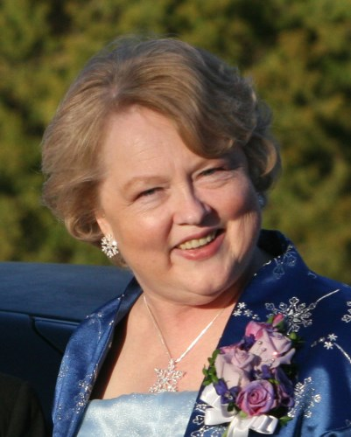
ARLENE HAGLUND Alpha Iota Chapter Initiated 5/1/1987 January 2, 2021 34 years
Arlene held many offices, including Chapter President. She was the past Literacy writer for Baystater
She was a teacher for 35 years in Boston Public Schools and was a Boston Teachers Union Building Representative.

Slide 35
MARGERY McKENNAN Alpha Iota Chapter Initiated 5/1/1990 May 21, 2020 30 years
Margery was an Honorary Member of her chapter because of her lifelong dedication to education and the children in her community. She served on the Norwood School Committee for 18 years.

Slide 36
MARGARET HITCHCOCK Alpha Lambda Chapter Initiated 6/1/1976 July 30, 2019 43 years
Margaret was a dedicated member of her chapter and actively participated in chapter activities.
She was a second-grade teacher at West Wareham Elementary School in West Wareham for 33 years.

Slide 37
RHETTA TUTTLE Alpha Lambda Chapter Initiated 4/1/1969 March 12, 2019 50 years
Rhetta was a dedicated member of Alpha Lambda Chapter.
She spent most of her 40-year teaching career teaching third grade at Center School in Mattapoisett.

Slide 38
BETTY SNYDER Alpha Mu Chapter Initiated 5/1/1979 May 1, 2019 40 years
Betty Snyder, a charter member of Alpha Mu, served as Chapter President and continued as a valued member for 40 years.
She was an elementary educator, teaching first and second grades at Hardwick Elementary and Hubbardston Center Schools.

Slide 39
May we find comfort in the treasured memories of those no longer with us.

Slide 40
In Appreciation of
Jo-Anne Butler, a devoted member and all around wonderful person!! This presentation would not have been possible without her hard work and dedication!
From all of us a sincere thank you!!

